Slide 1
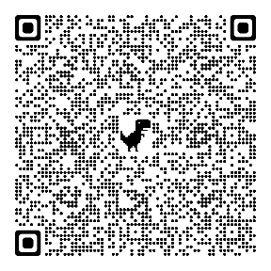
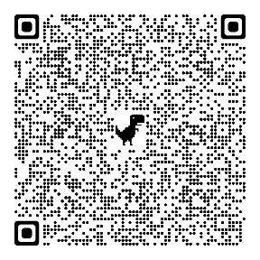
20th October 2021 at 7 pm
https://zoom.us/j/93874650550?pwd=ZTd5cHJDMWZKYUtaZEh3QmdCckRWZz09
Meeting-ID: 938 7465 0550
Kenncode: 571838
27th October 2021, 2 pm
https://us06web.zoom.us/j/85839717016?pwd=VGNtL2pjUU51K2JRSXF5UHJvZHZ1UT09
Meeting ID: 858 3971 7016
Passcode: 021218

